Slide 1
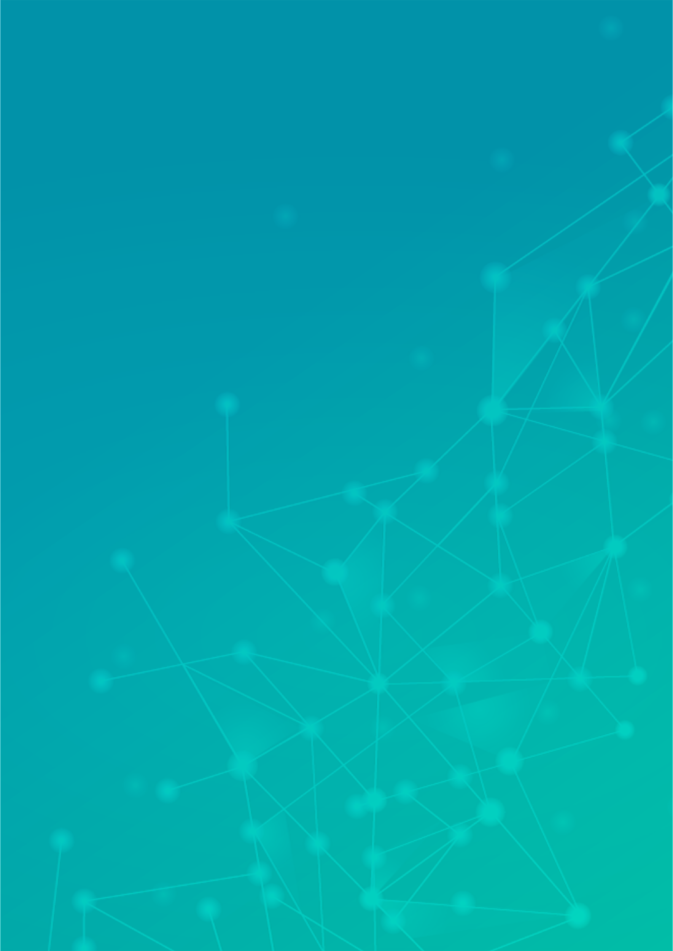
SIGN LANGUAGE DETECTING SYSTEM
A customizable sign language deep learning model that can be trained personally and make accurate predictions with the data collected in training.
Author: Harshita Agalcha
Notes:
Preworks course home assignments

Slide 2
Table of Contents
Acknowledgements
About Me
About My Internship Journey
About My App
How Do I Use My App
Contact Person

Slide 3
Acknowledgements
A small vote of thanks to my parents, to my teacher, Mr. Avishek Das, Dr. Ken, and to all my friends who have supported me in this journey!

Slide 4
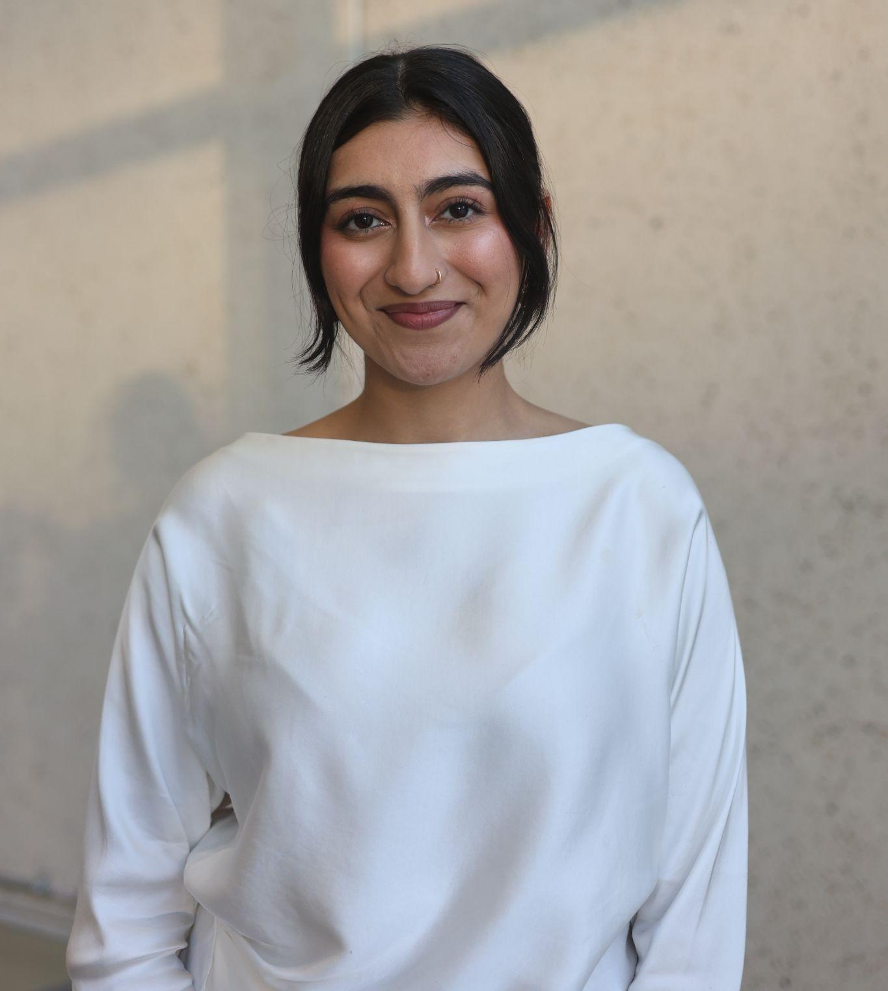
About Me..
My name is Harshita Agalcha and I’m a third year student at the University of Alberta studying Computer Science.
I’m 20 years old.
Harshita Agalcha

Slide 5
About My Internship Journey with Clevered
It was an amazing experience where I had the opportunity to learn from talented professionals and expand my knowledge in this field. I especially enjoyed the project building aspect of this internship journey and look forward to presenting it!

Slide 6
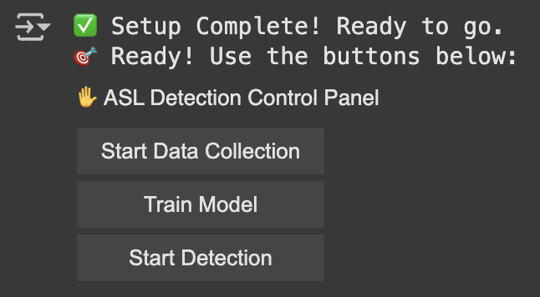
About App..
It’s a deep learning model that has been trained according to ASL and is able to live detect any hand sign. Despite it being trained in ASL, it has the capability to be trained in any sign language. It’s a real time detection system and has the feature of real time training as per user given data.

Slide 7
How do I use the App?

Slide 8
App UI Screen 1

Slide 9
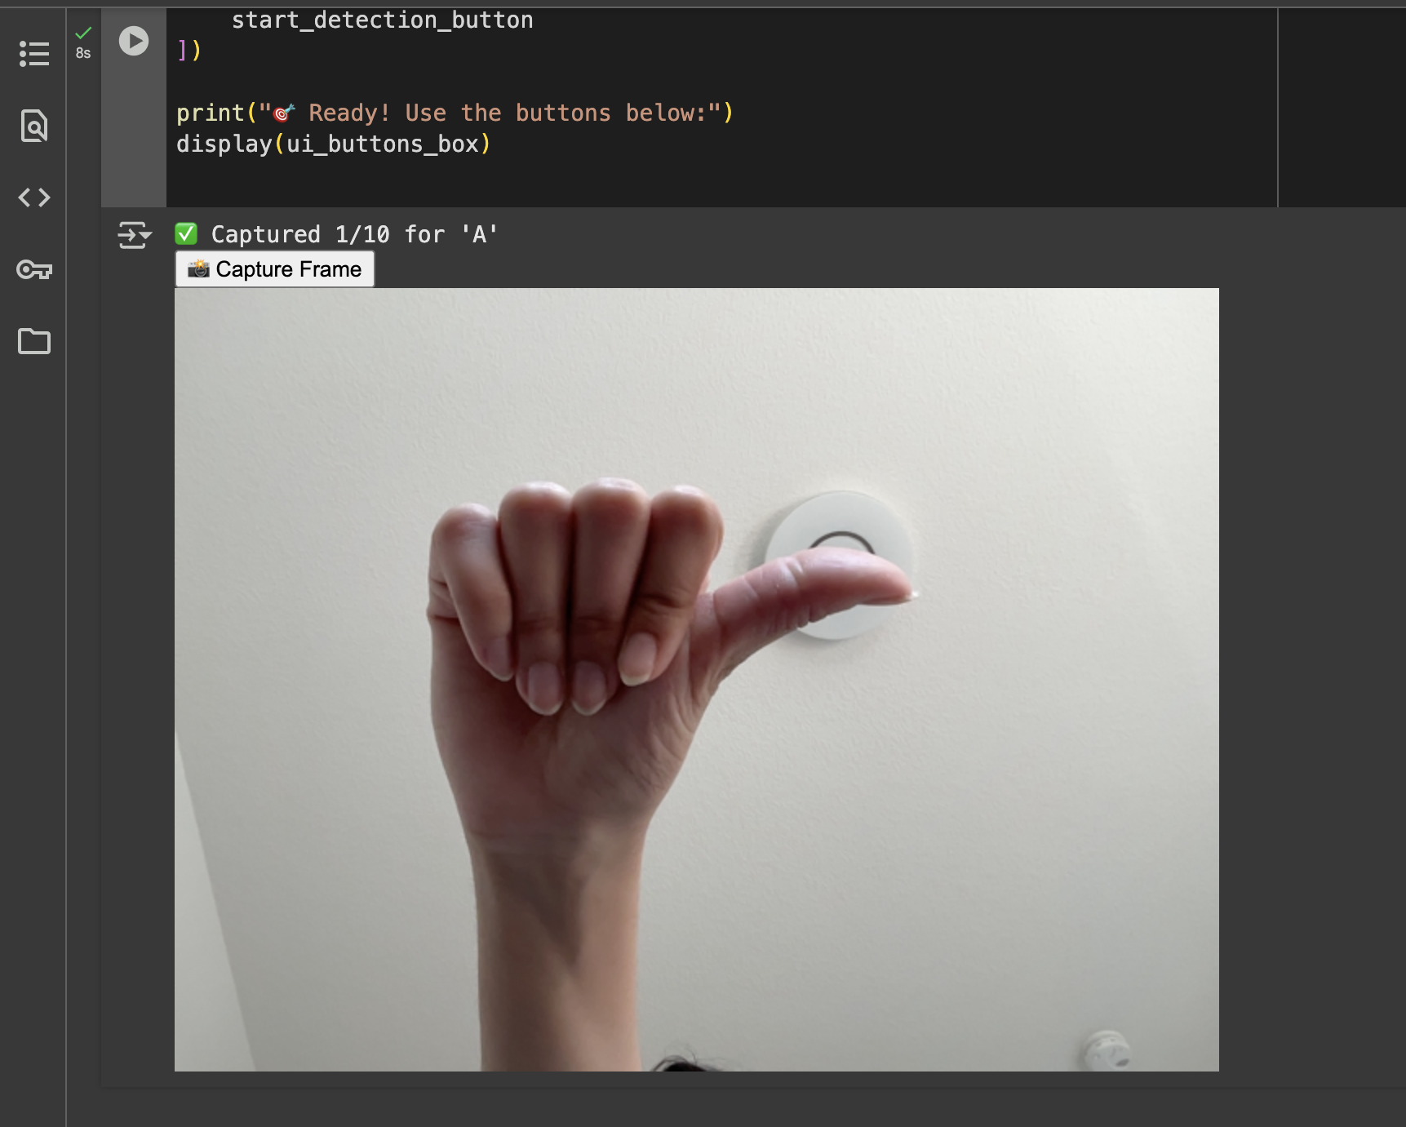
App UI Screen 2

Slide 10
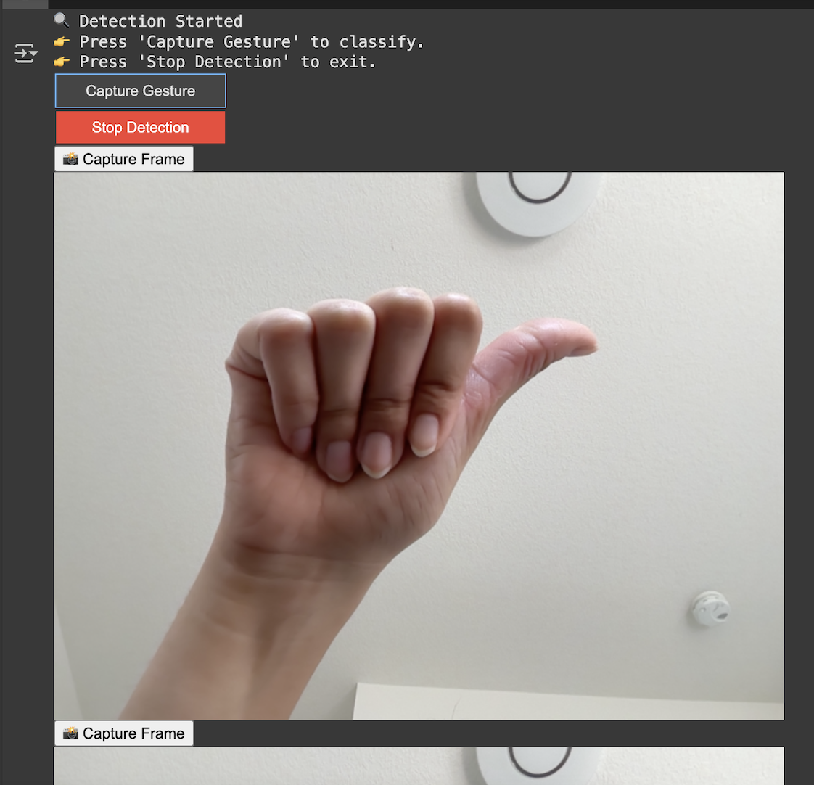
App UI Screen 3

Slide 11
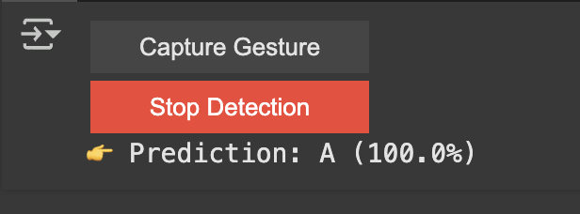
App UI Screen 4

Slide 12
Contact Person
Please reach out to Harshita Agalcha at harshitagalcha66@gmail.com for any questions/ concerns/ suggestions on the App

Slide 13
Thank you!

